Slide 1
DIRECT METHOD OF LINEAR MEASUREMENT

Slide 2
Various methods coming under the direct method of linear measurement are:
Direct Method # 1.
Linear Measurement by Pacing
Direct Method # 2.
Linear Measurement by Passometer
Linear Measurement by Pedometer
Linear Measurement by Odometer and speedometer
Linear measurement by perambulator

Slide 3
Direct Method # 3
Judging Distance and Time Measurements:
Direct Method # 4.
Linear Measurement by Chaining

Slide 4
Direct Method # 1.
Pacing Method:
The method consists in walking over a line which have been previously measured and counting the number of paces. However, the surveyor should standardize his pace length by practice. By knowing the average pace length distance may then be obtained by multiplying the number of paces with the average pace length.

Slide 5
Measurement by Pacing
The method is generally useful where approximate results are required such as for reconnaissance survey, locating details in small scale mapping etc.

Slide 6
Standardization of pace length
Try to walk straight
Speed should be normal
In pacing length of pace varies with the individuals and also with the nature of ground and speed of pacing.

Slide 7
Direct Method # 2.
Instrumental Method:
Some instruments like Speedometer of an automobile, Pedometer etc. may also be employed to find the distance approximately. Speedometer gives better results than pacing provided the route is smooth as along a highway.

Slide 8
Passometer
The passometer is a watch like instrument that is carried on the person’s pocket or tied on the man’s leg. This instrument records the paces when the man moves from one point to another.
This technique hence overcomes the monotony and strain in counting the paces by the surveyor. The distance is calculated as the product of the number of paces and the average length of the pace.

Slide 9
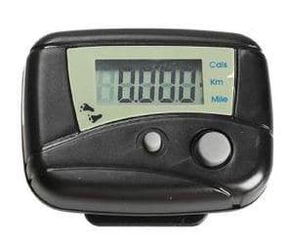

Slide 10
Pedometer
Pedometer is a similar device like passometer that automatically measures the distance. A pedometer is best in measuring the vertical distances.

Slide 11
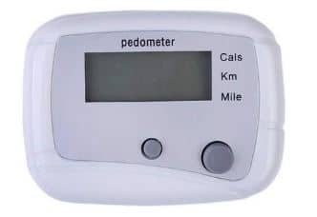

Slide 12
Odometer
Odometer is an instrument that measures the number of revolutions of a wheel. The number of revolutions taken to cover the length multiplied by the circumference of the wheel gives the value of the distance covered.
This instrument does not provide accurate results on an undulating surface. When the surface is smooth, the speedometer used in the vehicles can be used.

Slide 13
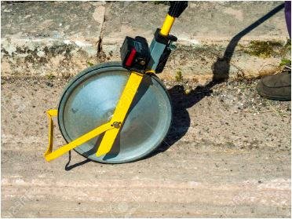

Slide 14
Speedometer
Follows the principle of odometer and directly gives the speed.

Slide 15
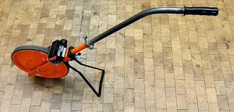
Perambulator
A surveyor's instrument for measuring distances. It consists of a wheel arranged to roll along over the ground, with an apparatus of clockwork, and a dial plate upon which the distance traveled is shown by an index.

Slide 16
Direct Method # 3.
Judging Distance and Time Measurements:
For very approximate results such as in reconnaissance survey, the distances may be determined by judgment only. The distances are also roughly determined by knowing the average time taken per km by a person at walk or a horse at trot and the total time taken to cover that distance.

Slide 17
Direct Method # 4.
Chaining:
The operation of measuring distance with the help of a chain or a tape is called chaining. It is the most accurate of all the methods of measuring distance and is commonly used. Ordinarily a chain is used for measuring the distance but where great accuracy is required, a steel tape is invariably used.

